Slide 1
Bolliger & Company Consulting Ltd.
HS Code Dispute and Resolution
9 November 2015
Malika Bhumivarn
Partner

Slide 2
Agenda
Tariff Classification rules
Tariff Ruling
Tariff Dispute
Tariff Resolution
Appeal Process

Slide 3
Tariff Classification Rule

Slide 4
Tariff Classification Rules
Tariff Classification
The current Customs tariff nomenclature is HS 2012
HS Code has been amended 4 times (in 1992, 1996, 2002, 2007 and 2012)

Slide 5
Why Tariff Code is important ?
Duty rate
Duty reduction privilege announced by the MOF
FTA
Import license
Export Control

Slide 6
Tariff code and import license
Color printer in HS 8443.31.10, 8443.31.20, 8443.31.30, 8443.31.90, 8443.32.90. 8443.39.11, 8443.39.20, 8443.39.30 and 8443.39.90 is required to obtain import license from Ministry of Commerce

Slide 7
Section, Chapter and Heading
Natural products
e.g. Lives animal
Chapter 1
Heading 01.01
Section 1
Chapter 2
Heading 01.02
Chapter 3
Heading 01.03
Chapter 4
Heading 01.04
Chapter 5
Section 2
Chapter 6
Section 3
Section 21
Chapter 97
Man-made products
e.g. Machine, Works of Art

Slide 8
General Rules for Interpretation: Rule 1
Classify in accordance with terms of headings and any relative Section or Chapter Notes
Example :
  Chilled apricots is classified in heading 0809 since Note 2 of Chapter 8 states that chilled fruits are to be classified in the same heading as the corresponding fresh fruits

Slide 9
Notes to Chapter 8 of Customs Tariff Decree B.E. 2530
  Chapter 8 - Edible fruit and nuts; peel of citrus fruit or melons
  Notes.
  1. This Chapter does not cover inedible nuts or fruits.
  2. Chilled fruits and nuts are to be classified in the same headings as the corresponding fresh fruits and nuts.
  3. Dried fruit or dried nuts of this Chapter may be partially rehydrated, or treated for the following purposes :
  For additional preservation or stabilisation (for example, by moderate heat treatment, sulphuring, the addition of sorbic acid or potassium sorbate),
  To improve or maintain their appearance (for example, by the addition of vegetable oil or small quantities of glucose syrup), provided that they retain the character of dried fruit or dried nuts.
08.09 | Apricots, cherries, peaches (including nectarines), plums and sloes, fresh.

Slide 10
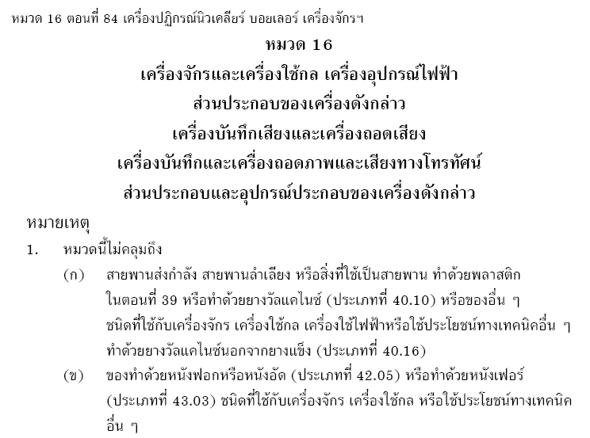
Example of General Rules for Interpretation: Rule 1

Slide 11
Example of General Rules for Interpretation: Rule 1

Slide 12
General Rule for Interpretation: Rule 2A
Incomplete or unassembled articles are classified as complete or finished articles if they have the essential character.
Example :
  evaporator and condenser (heading 8415.90, 10% duty rate) imported for producing air conditioner of heading 8415 (30% duty rate) – are treated as an importation of air conditioner and must be subjected to 30% duty

Slide 13
General Rules for Interpretation: Rule 2B
Mixtures and combination of materials or substances are classified according to Rule 3 in sequence.
Example :
  Milk to which vitamins or minerals have been added remains classified as milk

Slide 14
General Rules for Interpretation: Rule 3A
Goods classifiable under 2 or more headings shall be classified based on the heading which provides the most specific description.
Example :
  Tires for motor vehicles are classified in heading 4011 as tires of rubber rather than heading 8708 as parts and accessories of motor vehicles

Slide 15
General Rules for Interpretation: Rule 3B
Mixtures shall be classified based on the component which gives them their essential character.
Example :
  A belt comprising of 90% leather and 10% cotton is classified in heading 4203 as a leather belt

Slide 16
General Rules for Interpretation: Rule 3C
Goods that cannot be classified by Rule 3A or 3B shall be classified under the heading which occurs last in numerical order.
Example :
  A belt comprising of 50% textile and 50% leather is classified in heading 6217 as a textile belt.
 | Tariff Code | Tariff Rate
Leather belt | 4203.300029 | 40%
Textile belt | 6217.1000 | 30%

Slide 17
General Rules for Interpretation : Rule 4
Goods which cannot be classified by preceding rules shall be classified under the heading to which they are most akin.
Example :
  Sugar cane crusher is classified in heading 8435 as it is akin to a fruit juice crusher

Slide 18
General Rules for Interpretation : Rule 5A
Containers specially designed for specific goods shall be classified with such goods.
Example :
  Binocular cases should be classified in heading 9005 with the binoculars

Slide 19
General Rules for the Interpretation : Rule 5B
Packing materials not meant for repetitive use shall be classified in the same heading as the packed goods
Example :
  Metal cylinders of iron or steel for compressed or liquified gas which are for repetitive usage are classified in their own heading (7311)

Slide 20
General Rules for the Interpretation: Rule 6
Classification of goods in the subheadings of a heading shall be governed by Rules 1 to 5
Example :
  A piece of kitchen furniture made of wood and metal can be classified under either of the following subheadings :
  9403.20 – Other metal furniture
  9403.40 – Wooden furniture of a kind used in the kitchen

Slide 21
Tariff Ruling

Slide 22
Tariff Ruling
Customs Notification No. 39/2558 (2015) re: rules and conditions for advance ruling on customs tariff classification
One request per product
Binding for 2 years from date of issuance
Consideration process takes 30 working day from date of submission of request

Slide 23
Tariff Dispute

Slide 24
Common Causes of Tariff Dispute
Misunderstanding the nature of product
Different tariff interpretations
Overlook specific exceptions to tariff classification rules in Chapter Note or Explanatory Note
Conservative Assessment (High duty-rate base)

Slide 25
Types of Tariff Dispute
Customs at port inspected goods and disagreed with the Tariff codes declared in the Import entry,
Customs Suppression and Investigation stopped the shipment at the time of releasing the goods,
Customs Post Audit conducted the review retrospectively

Slide 26


Customs offense at the time of customs formality
Import Entry
Submit data to Customs computer system
Red line
Examine documents
DATA
Green line
Inspection and Release of goods

Slide 27
Settlement of Customs Dispute
Section 112 – Deposited Guarantee
In case the importer and customs officer disagree on the amount of duty of goods which are being passed through the Customs, the importer can deposit a guarantee covering the maximum duty payable for the goods as a guarantee (either in cash or bank guarantee), and pay the amount of duty declared in the entry, in order to remove the goods from custody of the Customs

Slide 28
Settlement of Customs Dispute
Section 112 bis
In case where a guarantee of the amount of duty is given under section 112 and the Customs officer has assessed the amount of duty payable and notified the importer, the importer shall pay the notified amount of duty within 30 days from the date of receiving the notice.
- In case where cash has been deposited as a guarantee and the cash deposit is sufficient to cover the amount of duty assessed by the customs officer, the assessed amount of duty shall be paid from such cash deposit immediately, and the importer shall be deemed to have paid the notified amount or duty within the period specified above.

Slide 29
Settlement of Customs Dispute
Section 112 quarter
- When the importer pays the duty or additional duty to be paid, a surcharge at the rate of 1 percent per month from the date of release to the date of payment shall be collected.

Slide 30
Deposit Guarantee
DATA
(customs computer system)
Green line
Red line
Place guarantee (depending on customs issue)
Examine tariff/value
Offense found
Offense found
Place guarantee (differential amount+ penalty)
Place guarantee (differential amount+ penalty)
Inspection & release
Inspection & release
Remove the goods from Customs custody

Slide 31


Deposit Guarantee
Deposit Guarantee
Submit data/ explanation
Customs officer issues Duty Assessment Notices
Appeal to Appeal Committee
Appeal to Court

Slide 33
Appeal Form (KSK 171)

Slide 34
Reserve Right for Refund
The right to claim the refund of overpaid duty is 3 years from the date of importation (2 years under current Customs Act)
The claim for a refund shall not be accepted for consideration after the payment of duty and the customs clearance of such goods, except in the case where a statement indicating an intention to claim is given to the competent official before customs cleareance or where the competent official should have known before the customs clearance that the duty paid is in excess of duty payable for the goods.

Slide 35
Right and Obligation of Importer
Advance Tariff Ruling
  Proactive measure
  2 years binding right
Place Guarantee or Reserve the right
  Cash Deposit or Bank Guarantee
Appeal to Appeal Committee
  Shall be made within 30 days
Self Declaration
  Post-import measure
Tariff /Valuation Dispute

Slide 36
Other Concerning Issue on Tariff/Valuation Dispute
Exposure or Liability amount
Previous and Future import
  Retrospective assessment of other shipment
  Import cost of future shipment and selling price
Other products in the same category
Other customs compliance
Alternative customs privilege mitigating the duty

Slide 37
Timeline
Provide supporting arguments
Importer
3-5 Month
3-5 Month
2 years and more
Provide argument to Tariff Bureau
Apply for Advance
Tariff Ruling
Appeal to Appeal Committee
Customs Memo
Customs Tariff Ruling
In-charge Staff
Sub-Committee
Committee
Tariff Consideration

Slide 38
Customs Procedure for Tariff Disputes
Importer
Provide documents and supporting argument
Duty Assessment Letter
X Tariff Dispute
Bangkok Port
Customs Office
Customs Department HQ
(Bangkok)
Customs
Service
Division
Internal inquiry
Tariff Bureau
6 month or more
Customs Memo
Appeal and
Provide supporting
arguments
Duty Assessment
Division
Importer
Appeal Committee for Tariff Consideration
Request for additional document
In-charge Staff
*** Either tariff confirmation from Tariff Bureau or Appeal Committee can be used against all charges
Review
2 years or more
Sub-Committee
Committee
Tariff Consideration

Slide 39
Process Beyond Customs Department
Customs Department HQ (Bangkok)
Importer
Appeal Committee for Tariff Consideration
Appeal and
Provide supporting arguments
In-charge Staff
Enquiry
Review
2 years or more
Sub-Committee
Committee
Issue Tariff Decision
Tariff Consideration
Court of Justice (Bangkok)
Disagree and Proceed
litigation within 30 days since the date of issuance of the Decision
Tax Court
Tax Court’s Judgement
Litigation Process
Supreme Court
Supreme Court’s Judgement

Slide 40
Settlement of Customs Dispute
Section 102
Subjected to Section 102 bis, if any person shall be liable to prosecution under the Customs Act, the Director-General, with the consent of such person and upon payment of fine, or the giving understanding, bond, or security as the Director-General may deem fit, may waive prosecution; and such waiver shall indemnify the offender against any further prosecution on account of the offense in question.

Slide 41
Procedures of customs accusation
Procedures of customs accusation after the inspection of Post-Clearance Audit Bureau or Customs Investigation and Suppression Bureau
Customs officers audit & inspect
Inform the accusation/issues
Suppress the case
Dispute the case
Legal Affairs Bureau
explain
Co-consultation with related officers
Suppress the case
Conclude the accusation/Duty Assessment Notice
Appeal the case to Appeal Committee
Suppress the case
File the case to Court within 30 days

Slide 42
Customs Penalty
Duty shortage
Duty Shortage +
Penalty 2 times +
VAT shortage +
VAT penalty 1 time +
VAT surcharge
Hand Carry/
Smuggling
Penalty 2 times of import
Price plus import duty and
seized the goods
Import goods
Without
import license
Amount of (CIF + I/D + VAT)
Falsified Document
Fine minimum 1,000-50,000 Baht

Slide 43
Process of Settling a Case
Economic Crime
Investigation Division
(under Royal Thai Police) or
Department of Special
nvestigation
Customs Litigation
Division,
Legal Affairs Bureau
Customs Audit/
Customs Investigation
& Suppression Bureau

Slide 44
Subject to Penalty ??
If found by Customs, subject to penalty 2 times
If company self request for putting guarantee, no penalty
Prove of no intention → No penalty

Slide 45
Criteria for prosecution and case settlement at the Customs level
In case of false declaration arising from the carelessness of the offender, the offender will be liable to a penalty of 10% of duty shortage, which shall not be less than 1,000 Baht but not exceed 50,000 Baht, as well as paying all deficient duties and VAT penalty accordingly.

Slide 46
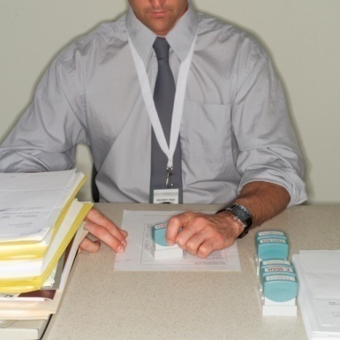
Criteria for prosecution and case settlement at the Customs level
False declaration in attempt to evade tax shall be subjected to payment of duty shortage + a penalty twice the duty shortage + VAT penalty 1 time the VAT shortage + excise tax + interior tax (if any)

Slide 47

Criteria for prosecution and case settlement at the Customs level
Offenses relating to importing or exporting restricted and prohibited goods:
  Prohibited goods imported into or exported from Thailand shall be forfeited
  For restricted goods, if the government authority responsible for issuing the license issues the license after the importation, or informs the customs officer in writing after the importation that it permits the importation of such goods into Thailand, the goods shall be subjected to a fine of 10% of value of goods, which will not be less than 1,000 Baht but not exceed 20,000 Baht, regardless of whether the goods are dutiable.

Slide 48
For more information, please contact :
Malika Bhumivarn, Partner
Tel: +66 (0) 2 625 6300
Mobile: +66 (0) 8 1 824 7450
Fax: +66 (0) 2 625 6311
Malika.Bhumivarn@bolliger-consulting.com
Bolliger & Company Consulting Limited. is a consulting firm of non-lawyer
professionals and a subsidiary of the law firm Bolliger & Company Consulting.
© 2014 Bolliger & Company Consulting Limited. All Rights Reserved.

